Slide 1

sentiment analysis of movie reviews
Done by :
Anas Nofal

Slide 2

1
2
DESCRIBING THE PROBLEM
AND THE DATA
DATA PREPARATION
3
4
Clustering
And TextBlob Sentimenting
Movie Evaluation

Slide 3
01
DESCRIBING THE PROBLEM
AND THE DATA

Slide 4
Sentiment analysis
It’s the process of analyzing online pieces of writing to determine the emotional tone they carry, whether they’re positive, negative, or neutral.
In simple words, sentiment analysis helps to find the author’s attitude towards a topic

Slide 5

Describing the problem
To rate a movie based on tweets from twitter using sentiments analysis and nlp techniques
sentiments analysis techniques
Rate from 10
tweets

Slide 6
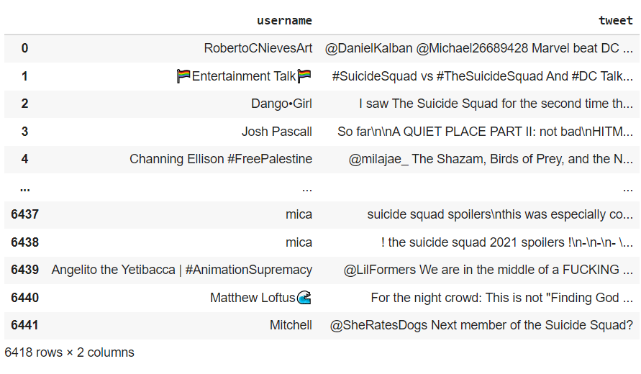
The data set
The data was gathered from twitter using the Twitter API.
The collected data contain 6418 tweets

Slide 7
02
DATA PREPARATION

Slide 8
Cleaning the data
Letter casing : Converting all letters to either uppercase or lowercase.
Tokenizing : Turning the tweets into tokens. Tokens are words separated by spaces in a text.
Noise removal : Eliminating unwanted characters, such as HTML tags, punctuation marks, special characters, white spaces etc.
Stopword removal : Some words do not contribute much to the machine learning model, so it's good to remove them. A list of stopwords can be defined by the nltk library, or it can be business-specific.
Stemming :Stemming is a technique used to extract the base form of the words by removing affixes from them. It is just like cutting down the branches of a tree to its stems. For example, the stem of the words eating, eats, eaten is eat.
Lemmatization: lemmatization converts words into their base forms. In linguistics, lemmatization helps a reader consider a word’s intended meaning instead of its literal meaning. Because of that, lemmatization is often confused with stemming. For example, the lemma of the word Better is Good.

Slide 9
Cleaning the data
Quick cleaning techniques using re library
def clean_text(text):
text=text.lower() #letters casing convert all letter to lowercase
text=re.sub(r"@[A-Za-z0-9_]+",'', text) #remove mentions
text= re.sub(r'#','',text) #remove mentions
text= re.sub(r'\n','',text)#remove \n
text = re.sub(r"http\S+|www\S+|https\S+", '', text, flags=re.MULTILINE) # Remove urls
return text

Slide 10
Tokenizing and more cleaning
Cleaning using nltk library
def tokens(text):
tok=[i for i in text if not (i.isdigit())] #for digit
tok=''.join(tok)
tok=[i for i in tok if i in (string.ascii_letters + ' ')] #for non english words
tok=''.join(tok)
tok=[i for i in tok if i not in string.punctuation] # for the punctuation
tok=''.join(tok)
tok=[word for word in tok.split() if word not in stopwords.words('english')] # for the stop words
final=[]
for i in tok: # stemmer & lemmatizer
i= porter_stemmer.stem(i)
i=wordnet_lemmatizer.lemmatize(i)
final.append(i)
return final

Slide 11
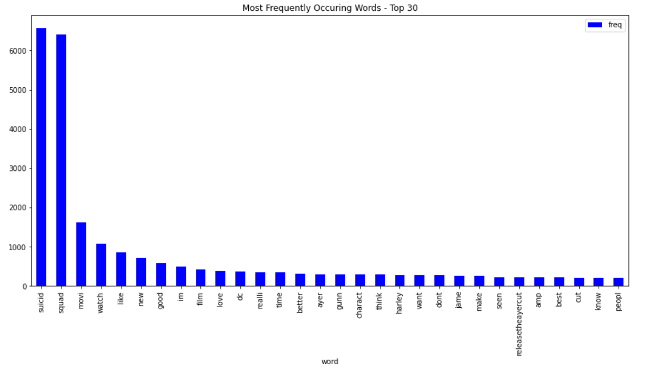
Most Frequently Occuring Words

Slide 12
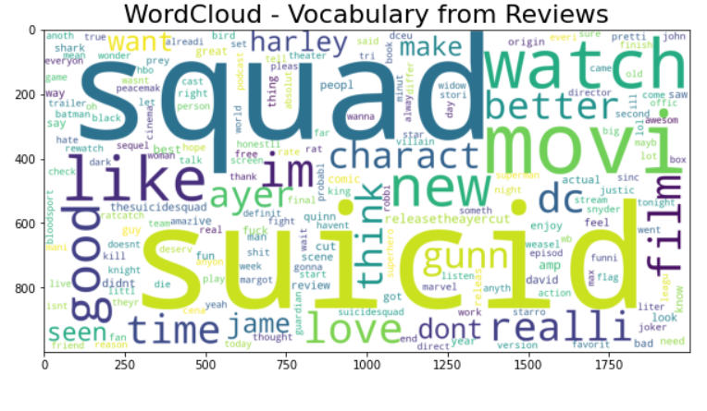
WordCloud

Slide 13
Vectorizing the Data
is the process to convert tokens to numbers. It is an important step because the machine learning algorithm works with numbers and not text.\
CountVectorizer : It is used to transform a given text into a vector on the basis of the frequency (count) of each word that occurs in the entire text. This is helpful when we have multiple such texts, and we wish to convert each word in each text into vectors (for using in further text analysis).
TfidfVectorizer : It gives us the recurrence of the word in each report in the corpus. It is the proportion of the number of times the word shows up in a report contrasted with the all-out the number of words in that record. It increments as the quantity of events of that word inside the record increments.

Slide 14
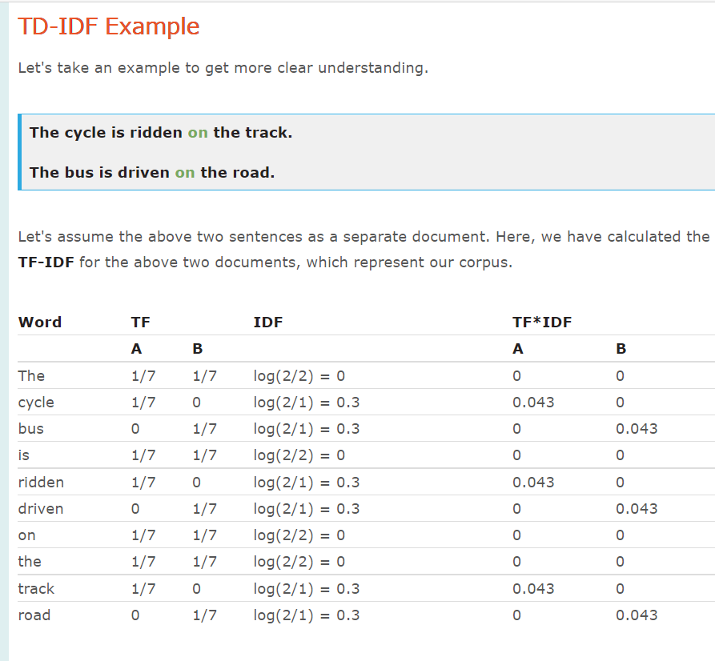
TfidfVectorizer

Slide 15
03
Clustering
And TextBlob Sentimenting

Slide 16
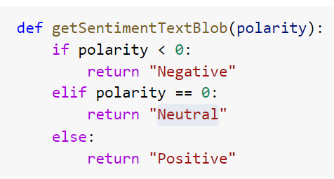
TextBlob Sentimenting
The data is classified as positive, negative, or neutral using polarity.
Then Converting it into numbers by using this function

Slide 17
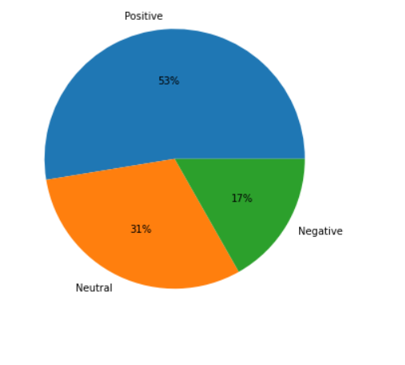
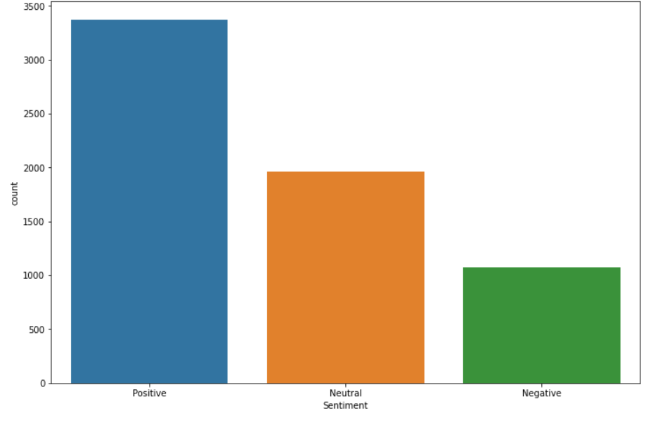
TextBlob Sentimenting

Slide 18
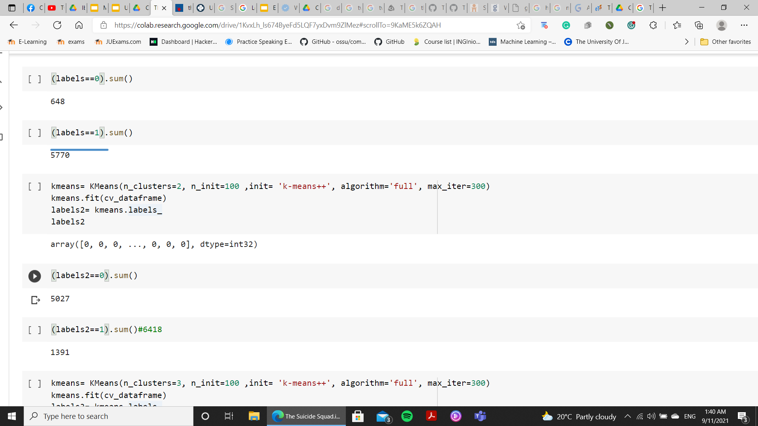
Clustering
By using k-means Clustering to divide the tweets into positive and negative .
I used three type of Vectorizing which are CountVectorizer ,TfidfVectorizer and the tf_idf_vec_smooth
And the best result was with CountVectorizer

Slide 19
04
Movie Evaluation

Slide 20
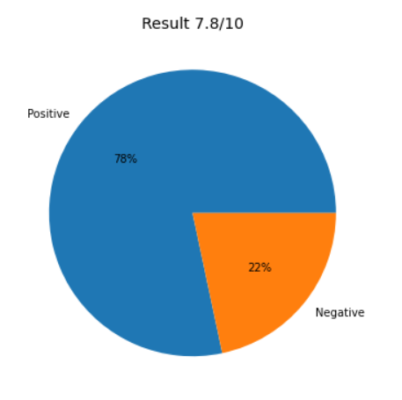
By using Clustering

Slide 21
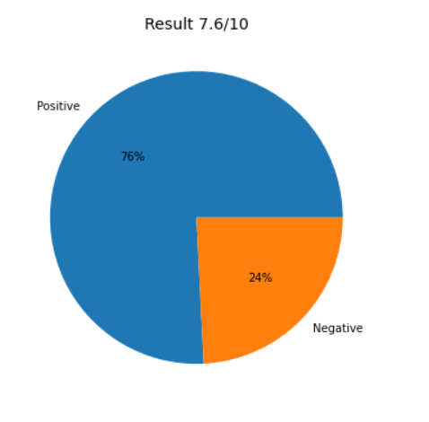
By using TextBlob Sentimenting

Slide 22
Thank you

